Slide 1
Modern Analytics Academy
Data Pipeline Overview
https://aka.ms/maa
Notes:
Hello, welcome to Modern Analytics Academy

Slide 2





Modern Analytics Academy Team
Alex Karasek
Annie Xu
Brian Hitney
Chris Mitchell
Jason Virtue
Senior Cloud Solution Architect
Senior Cloud Solution Architect
Senior Cloud Solution Architect
Principal Cloud Solution Architect
Principal Cloud Solution Architect
https://aka.ms/maa
Notes:
We are a group of Microsoft Cloud Solution Architects focusing on Analytics and AI

Slide 3
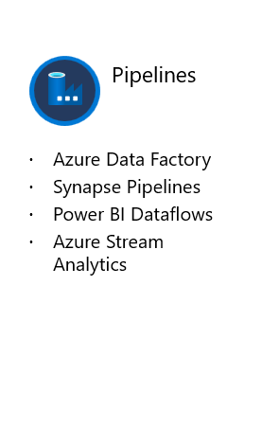





Academy Sessions
Acquisition & Storage
Modeling
Pipelines
Security & Governance
Visualization
Azure Data Lake
Azure Cosmos DB
Azure Event Hubs
Synapse Link
Data Lake Structure
Synapse Spark Pools
Synapse SQL Pools
Synapse Serverless SQL
Azure Data Factory
Synapse Pipelines
Power BI Dataflows
Azure Stream Analytics
Auditing
Security
Azure purview
Power BI
Paginated Reports
Power BI Embedded
https://aka.ms/maa
Notes:
There 5 sessions in Modern Analytics Academy series including A&S, Modeling, Pipeline, S&G and Visualization. This session focuses on Data Pipelines. If you are interested in other sessions, you can go to aka.ms/maa.

Slide 4
Agenda
What is Data Pipeline
Data Factory
Synapse Pipelines
Power BI Dataflows
Azure Stream Analytics
Notes:
Today, we will start with the definition of Data Pipeline. Then moving into 4 services on Microsoft cloud and each of them come with a Demo by the end of it.

Slide 5
What is Data Pipeline
Definition
Key Concepts
Data Pipeline Services On Azure
Notes:
First, what is data pipeline and what key concepts are related to it.

Slide 6
What is Data Pipeline
“Data Pipeline also known as Data Integration - allowing you to move data between services and orchestrate activities.” – Source Microsoft Synapse Blog
“In computing, a pipeline, also known as a data pipeline,[1] is a set of data processing elements connected in series, where the output of one element is the input of the next one. The elements of a pipeline are often executed in parallel or in time-sliced fashion. Some amount of buffer storage is often inserted between elements.” – Source Wikipedia
“Data pipelines move data from one source to another so it can be stored, used for analytics, or combined with other data. That’s the simple definition; more specifically, a data pipeline is an end-to-end process to ingest, process, prepare, transform and enrich structured, unstructured, and semi-structured data in a governed manner.” – Source Informatica
Notes:
Data pipelines move data from one or multiple sources to another source so it can be stored, used for analytics, or combined with other data.

Slide 7
Effectively integrating data is more important than ever
80%
of enterprise Business Operations leaders say data integration is critical to ongoing operations
67%
rely on data integration to support analytics and BI platforms today, and 24% plan to in 12 months
65%
of organizations prefer cloud platforms or hybrid cloud data integration solutions
Source: The State of Enterprise Data Integration, Forbes 3/29/2020
Notes:
Now more than ever, enterprises are placing a high priority on data integration, especially to support analytics and Business Intelligence (BI) initiatives corporate-wide.
80% Business Operations leaders, including those from service delivery, manufacturing, and supply chain, say data integration is critical to their success
67% of enterprises are relying on data integration to support analytics and BI platforms today, and 24% are planning to in the next 12 months.
65% of organizations prefer to deploy data integration solutions from cloud platforms or hybrid cloud.
Source: The State of Enterprise Data Integration, Forbes 3/29/2020

Slide 8
What are the key concepts in data pipeline
Source and Destination
Data connections
ETL or ELT
Activities
Pipeline
Triggers
Orchestration
Notes:
Source and destination is the location of your data
Data connections defines how the pipeline services link to your source or destination. It includes data path, data type, authentication information
ETL or ELT – E stands for Extract, T stands for Transformation and L stands for Load. It’s the process of how you move your data.
Each Activity stands for a step of your ETL process.
Pipeline is the logical group of Activities to accomplish a high-level task.
Triggers decides when you want your data pipeline to run.
Data Orchestration is the automation of data-driven processes from end-to-end

Slide 9

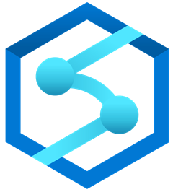
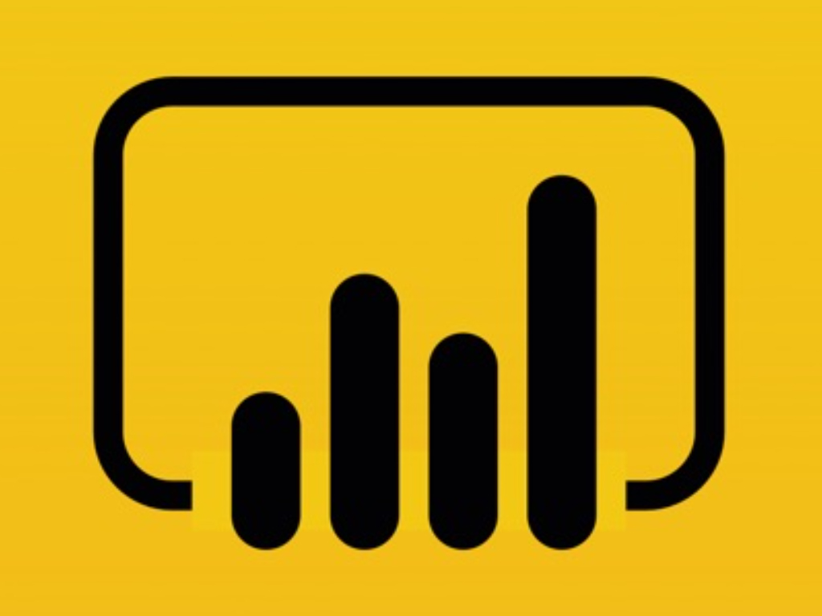

What services in Microsoft Cloud Support Data Pipeline Functionality?
Data Factory
Synapse Pipelines
Power BI Dataflows
Azure Stream Analytics
…
Notes:
There are many services supports data pipeline functionalities.
We selected 4 mostly used ones on azure to demonstrate you the idea of data pipeline.

Slide 10
Azure Data Factory
Notes:
The first service I would like to introduce you is Azure Data Factory

Slide 11
Azure Data Factory
Hybrid data integration, simplified
Easy-to-use
Cost-effective
Powerful
Intelligent
Code-free ETL/ELT
Rehost SSIS in a few clicks
Built-in Git & CI/CD
Pay-as-you-go
Fully managed, serverless
Scales on demand
90+ built-in connectors
Orchestrate and monitor at scale
Autonomous ETL
AI based intent-driven copy
Predictive pipelines
Notes:
Data Factory is the right solution to integrate all your data, especially when combined with other Azure technologies. Data Factory is a fully managed, serverless data integration service that’s easy-to-use, cost-effective, powerful and intelligent.
Easily construct ETL and ELT processes code-free in an intuitive environment or write your own code.
Visually integrate data sources with over 90 built-in, maintenance-free connectors at no added cost.
Then deliver integrated data to Azure Synapse Analytics to unlock limitless insights.

Slide 12



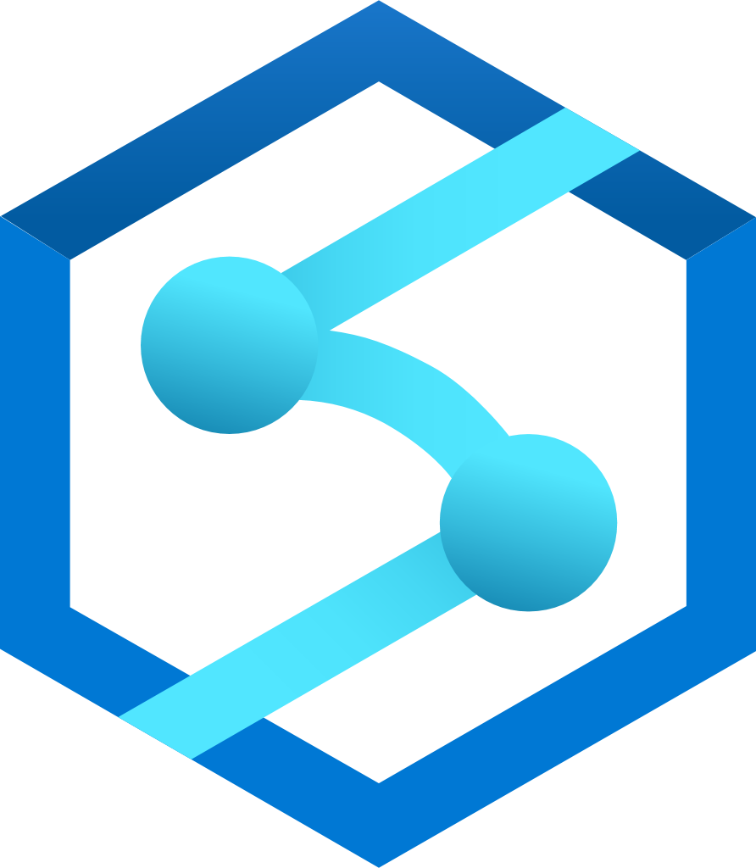





Azure Data Factory overview
Audiences
Data Engineer
Data Scientist
Citizen Integrator
Data sources
Ingest
Prepare, transform, predict & enrich
Serve
Visualize
Wrangling data flow
Mapping data flow
On-premises data
90 + Pre-built connectors
Code-free
Azure
Synapse Pool
Power BI
OR
Code-centric
Multicloud data
Databricks
…
Azure ML
HDInsight
Orchestrate and Monitor
SaaS data
Azure Data Lake
Notes:
Data Factory is a key enabler to help you reach your Analytics goals.
Let’s start with the data sources we’ve talked about including, on-premises data, multicloud data and SaaS data.
Over 90+ pre built connectors help you ingest data and cutting short the time and effort that you would otherwise apply.
Data engineers can choose to go code-free, prepping their data with Wrangling Data Flows and transforming with Mapping Data Flows, or go code-centric with the support of compute engines of their choice including Azure Databricks, Azure HDInsight, etc..
The data can then be served with Azure Synapse Pool and visualized using Power BI.
All the while, Data Factory enables data engineers to continuously orchestrate, monitor and troubleshoot from the same intuitive UI.

Slide 13


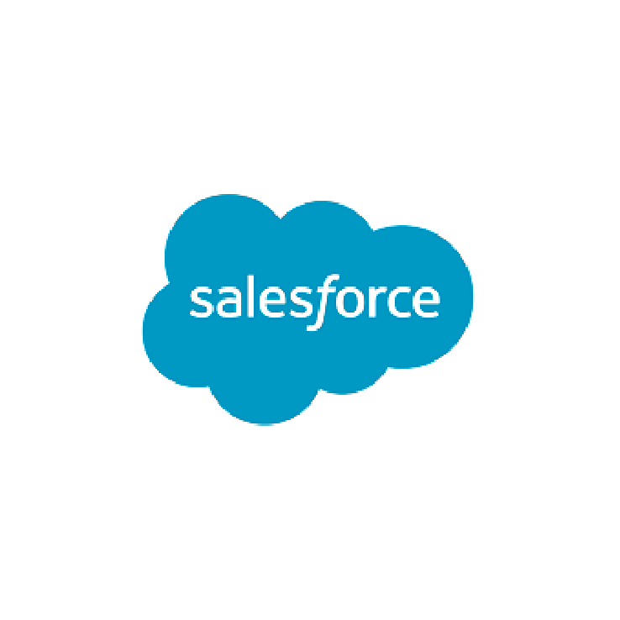
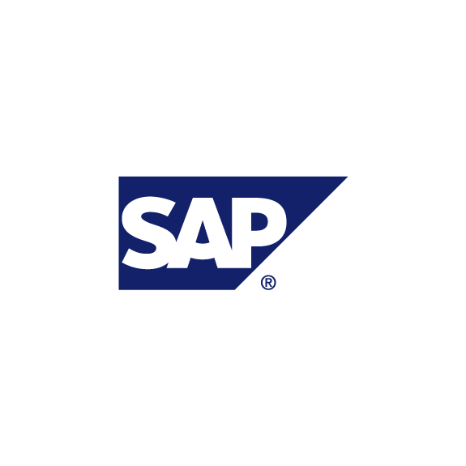



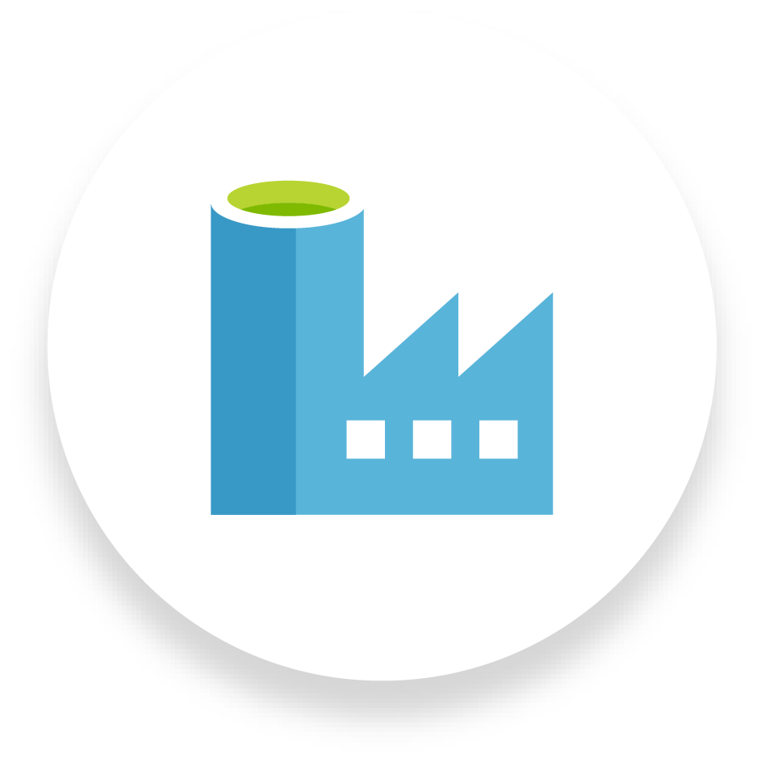

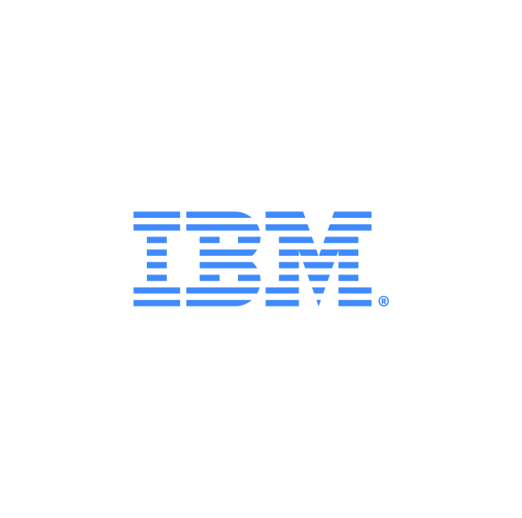
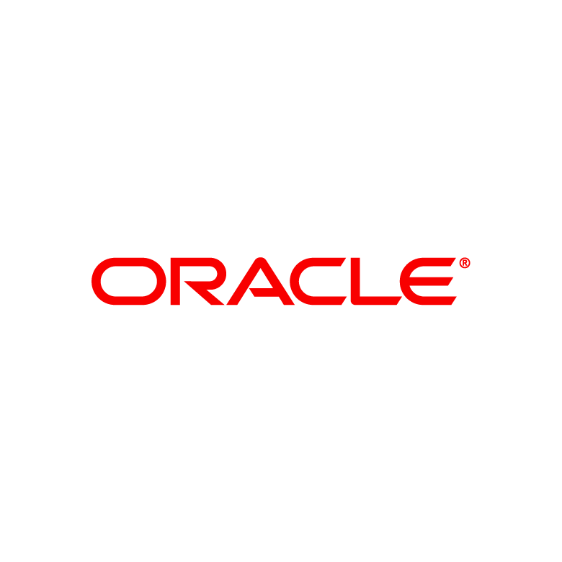

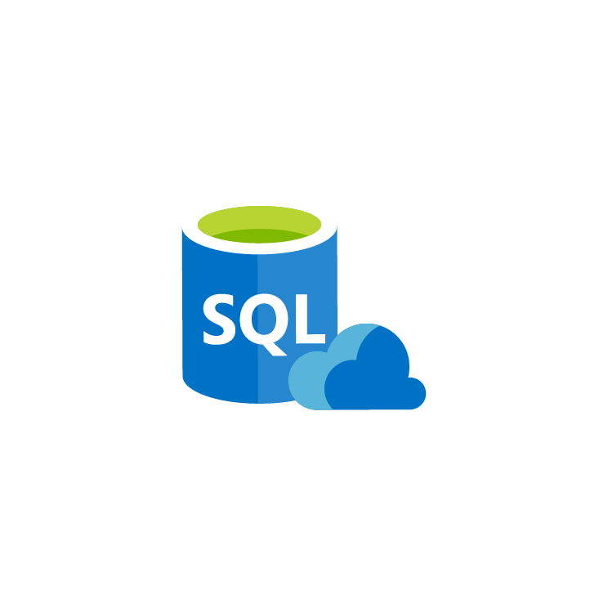

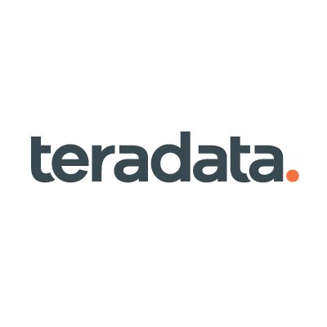

Ingest all your data with 90+ built-in connectors
90+ built-in connectors to ingest.
Big Data - Amazon Redshift, Google Big Query, HDFS
EDW - Oracle Exadata, Teradata
SaaS apps - Salesforce, Marketo, ServiceNow
All Azure Data Services
Leverage up to 5 GB/sec network bandwidth
Unified data integration solution to power up operational databases, machine learning, BI/ Analytics and app modernization
ServiceNow
Amazon S3 and Redshift
SAP HANA and Table
Salesforce
Marketo
HDFS
SaaS applications
Big data sources
Dynamics
Google Cloud Storage and BigQuery
NoSQL
Mongo DB
File
Azure Data Factory
Enterprise data warehouses
Netezza
File System
Azure Data Services
FTP/SFTP
Oracle Exadata
Azure SQL DB
Teradata
Azure Synapse Analytics
Azure Storage
Cosmos DB
Notes:
Lets start with the Ingest piece. Data Factory enables you to ingest all your data because it comes with over 90 built-in connectors.
With these connectors, you can ingest data from multicloud sources such as AWS, Google, on-premises sources such as Teradata and Oracle, as well as all Azure Data Services such as Cosmos DB, Azure SQL DB as well as SaaS apps such as Salesforce and Marketo.
You have the full capacity of up to 5GB/sec throughput network bandwidth behind you.
Data Factory is a powerful and unified data integration solution that powers your operational database, machine learning, BI/Analytics and app modernization.

Slide 14
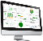

ADF Integration Runtime (IR)
ADF compute environment with multiple capabilities:
Activity dispatch & monitoring
Data movement
SSIS package execution
To integrate data flow and control flow across the enterprises’ hybrid cloud, customer can instantiate multiple IR instances for different network environments:
On premises (similar to DMG in ADF V1)
In public cloud
Inside VNet
Bring a consistent provision and monitoring experience across the network environments
Portal Application & SDK
Azure Data Factory Service
Self-Hosted IR
Azure IR
Data Movement & Activity Dispatch on-prem, Cloud, VNET
Data Movement & Activity Dispatch In Azure Public Network, SSIS
VNET coming soon
Notes:
ADF is the compute environment within ADF.
It has 3 versions of ADF:
Self-hosted IR which allows your to orchestrate data movement activates between on-premise environment to cloud.
The default Azure IR supports the data movement & activities in azure public network, azure managed vnet or private endpoints
SSIS IR supports SSIS package run on azure

Slide 15
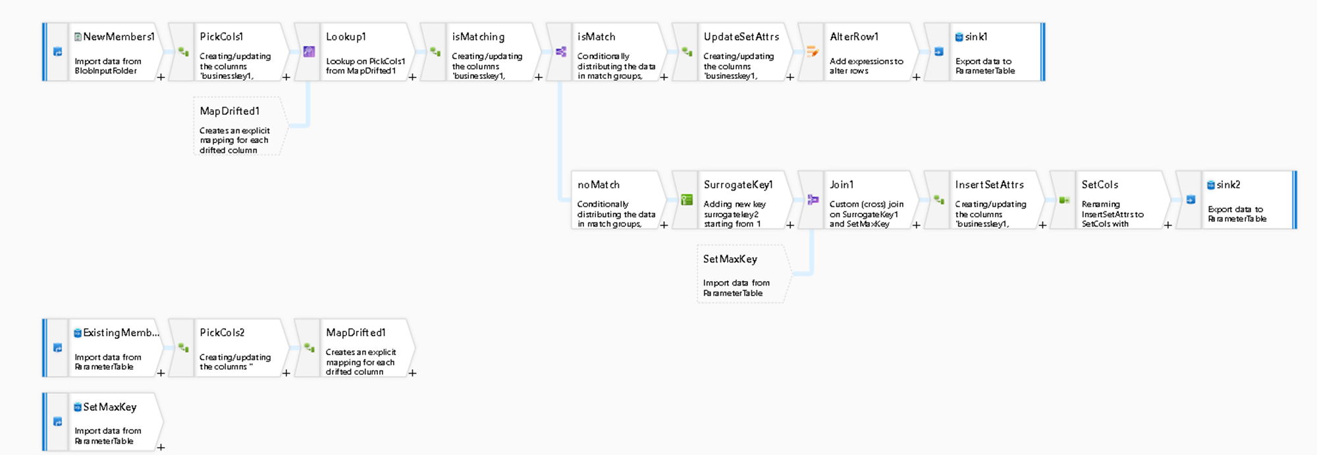
Transform code-free and/or code-centric, you choose
Code-free transformation at scale with Mapping Data Flow
Construct and perform ETL and ELT processes in an intuitive environment
Spend less time on design, testing, and maintenance, while focusing on business logic
Data cleansing, transformation, aggregation, and conversion
Cloud scale via Spark execution
Resilient, easily built data flows
Notes:
Next, with Data Factory, you can choose to work on, code-free or code-centric data transformation.
With Mapping Data Flow, a visually designed data transformation in Data Factory, you can develop graphical data transformation logic without writing code.
Data flow activities can be engaged via existing Data Factory scheduling, control, flow and monitoring capabilities.
Data Factory handles all the code translation, path optimization, and execution of your data flow jobs so you spend less time on design, testing and maintenance while focusing on busines logic.

Slide 16
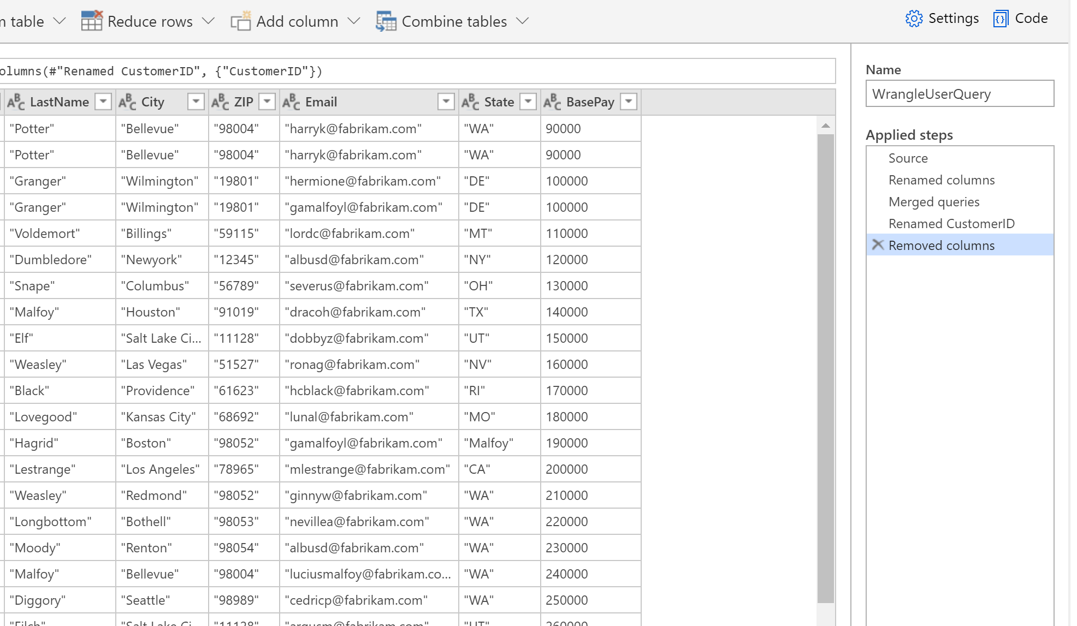
Prepare with Wrangling Data Flows (Power Query)
Perform code-free, agile data preparation at scale via Spark execution
Get started easily with familiar Microsoft Excel like UI
Choose from a variety of wrangling functions like combining tables, adding columns, and reducing rows
Create, debug, schedule, and monitor the wrangling data flow in a one-stop-shop
Notes:
Next, Data Factory wrangling data flows allow you to prepare data by performing code-free, agile data preparation at cloud scale via spark execution.
Quickly design, build and manage wrangling data flows with the performance you need to prepare your data for downstream analytics.
Our code-free browser-based grid designer provides an accessible visual environment to built your complex data preparation workflows.

Slide 17
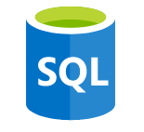


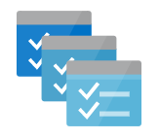
Transform code-free and/or code-centric, you choose
Fully contained operationalization for code-centric computing
ADF comes with completely integrated external compute engines
Azure Databricks
Notebook, Jar, Python
Azure HDInsight
Hive, Pig, Spark, MapReduce, Streaming
Synapse SQL Pool, Azure SQL DB & SQL Server
Stored Procedure
Machine Learning
Batch Execution, Update Resource
Azure Functions
Function calls
Azure Batch
Custom Executable
Notes:
Of course if you prefer to handle data transformation with code, Data Factory helps you do that, too with fully contained operationalization for code-centric computing.
Data Factory comes with six easily integrated external compute engines like Azure Databricks, Azure Functions, Azure Batch, Machine Learning and more.

Slide 18
Orchestrate at scale
Trigger
On demand
Schedule
Data Window
Event
Pipeline
For each (…)
…
Activity
Activity
Activity
Activity
Activity
Workflow
Control flow
Connectivity
Self-hosted
Integration Runtime
Azure
Integration Runtime
Linked service
Legend
On-prem Apps & Data
VNet
Azure Services
VNet
Command and Control
Data
Notes:
With ADF you can monitor all your pipeline activity from within a visual UI.
Set triggers on-demand and schedule processing the data based on your demands.
Once you've created and published a pipeline in Azure Data Factory, you can associate it with a trigger or manually kick off an ad hoc run.
You can monitor all of your pipeline runs natively in the Azure Data Factory user experience. Monitor activities within your data pipelines natively within ADF or using Azure Monitor.
Leverage the REST API interface to enable 3rd party integration.
Administer, maintain and monitor your pipelines and much more.
Additionally you can also set up alerts and debug before issues proliferate any further.
The Integration Runtime (IR) is the compute infrastructure used by Azure Data Factory to provide data integration capabilities across different network environments.
Azure IR provides a fully managed compute to natively perform data movement and dispatch data transformation activities to compute services like HDInsight. It is hosted in Azure environment and supports connecting to resources in public network environment with public accessible endpoints. Integration runtimes are available in self-hosted, Azure-SSIS, Azure, and Azure managed Vnet flavors.

Slide 19
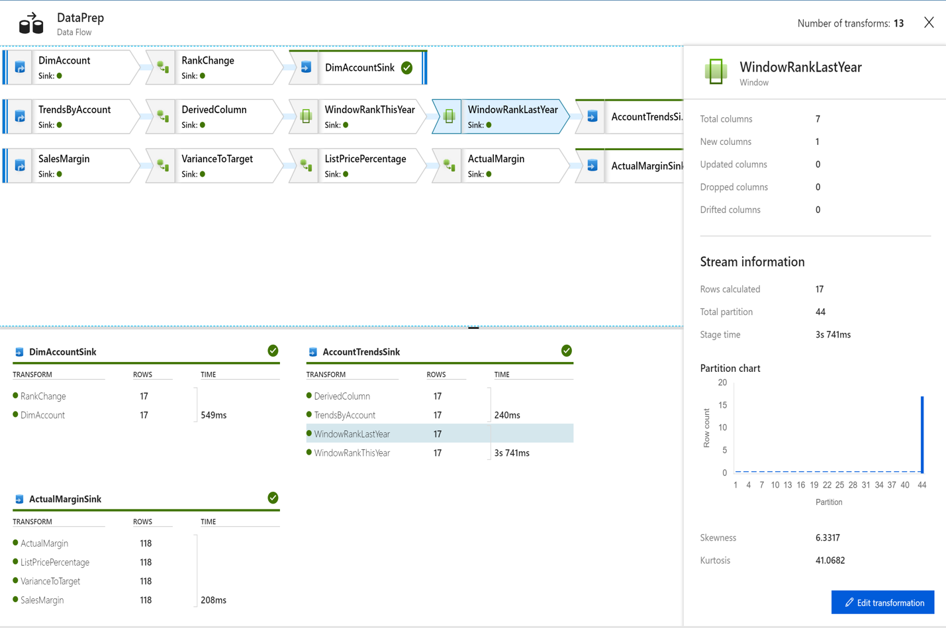
Monitor: Best-in-class management
Lower your cost of deployment, testing, and maintenance by monitoring pipeline and activity runs with pre-built templates and UI-based views
Query Runs with rich language
Reference operational lineage between parent-child pipelines
Integrate Azure Monitor for diagnostics loggings, metrics and alerts, anF events.
Restate pipeline and activities
Notes:
Data Factory is fully managed, so you focus less time on testing and maintenance.
Monitor pipeline and activity runs with easy-to-use pre-built templates and UI based views.
Work with Azure Monitor for diagnostics loggings, metrics and alerts and events.

Slide 20
Migrate SSIS to the cloud to realize cost savings
Greater potential – enable saving up to 88%*
Modernize SQL server and SSIS in tandem to lower TCO significantly.
The only fully compatible solution
Migrate all your workloads, custom and third-party components to the cloud.
Easy-to-use
Use the Data Factory deployment wizard tool and refer to how-to documentation.
Experience the benefits of the cloud
Focus on your data while dedicated data integration does the rest.
Unlock limitless insights with Azure Synapse
Query data on your terms using dedicated on-demand or provisioned resources – at scale
Azure Data Factory
Cloud-native ELT PaaS for MDW
Azure Data Factory SSIS
ETL PaaS SQL Server modernization
SSIS
ETL for managing SQL Server on premises/IaaS
*Azure Data Factory pricing details
Notes:
If you haven’t already considered the benefits of modernizing your SSIS, they are in fact quite substantial.
When you modernize your SQL server in tandem with your SSIS you’ll lower TCO significantly, up to 88%
Data Factory is the only solution that lets you migrate all of your workloads, custom and third-party components to the cloud.
You can unlock limitless data insights with Azure Synapse, querying data on your own terms using dedicated, on-demand or provisioned resources at scale.
Here is an elevator analogy for you
Running your legacy ETL workloads on premises is the ground floor
Running modern ELT workloads in the cloud on a fully managed Platform as a Service (PaaS) is the 7th floor, (click for animation) so jumping 7 stories straight up is virtually impossible
SSIS in ADF is the escalator that seamlessly carries you to the 7th floor (click for animation) step-by-step with the option to get on/off anytime at any floor.

Slide 21
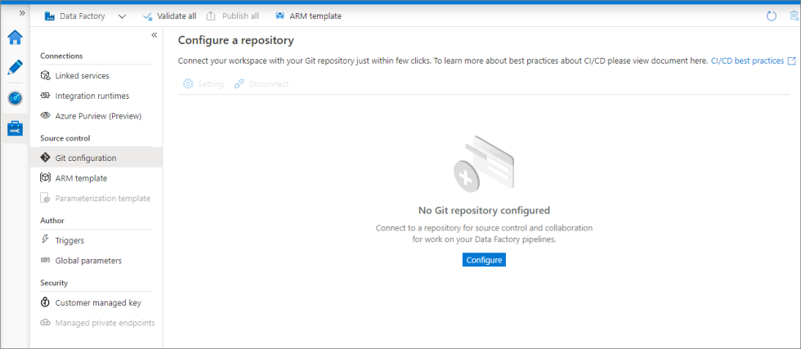
Source control in Azure Data Factory
Source control - Azure Data Factory | Microsoft Docs
Notes:
Lastly, Git integration allows you to achieve change management, source control, or CICD goals.

Slide 22
ADF Demo

Slide 23
Synapse Data Pipeline
Notes:
Next service – let’s talk about Azure Synapse Analytics, specifically focusing on Synapse Data Pipeline module

Slide 24
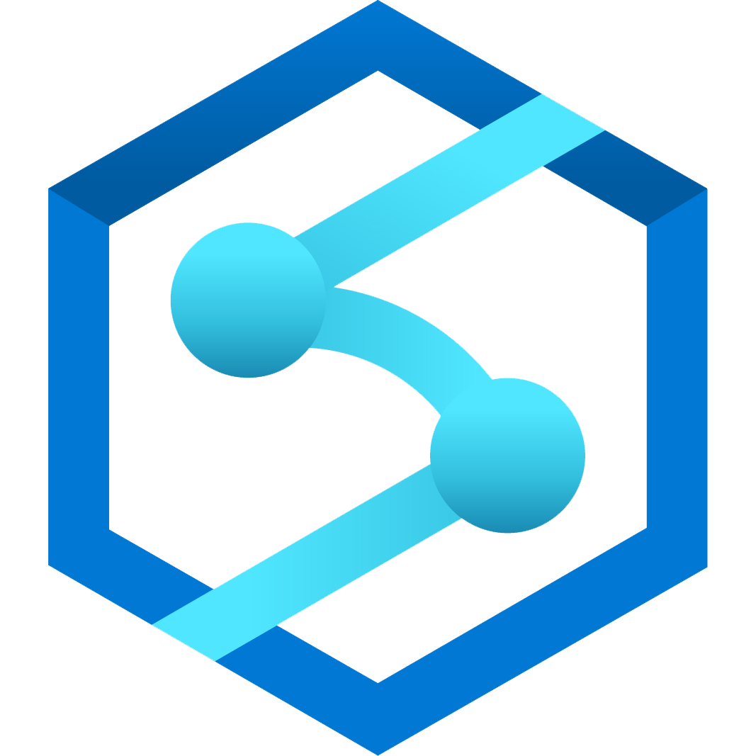
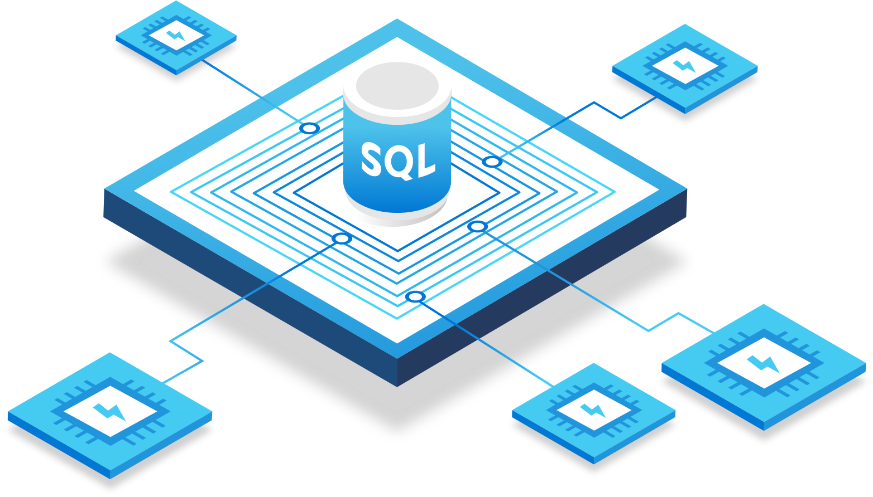
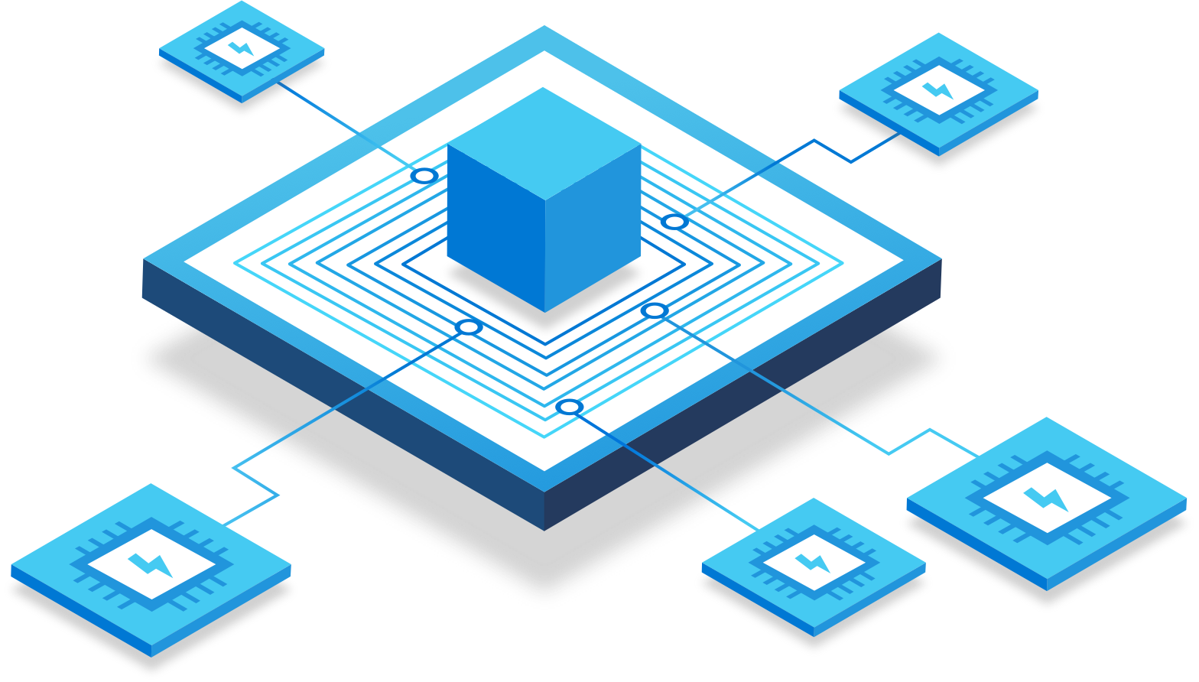
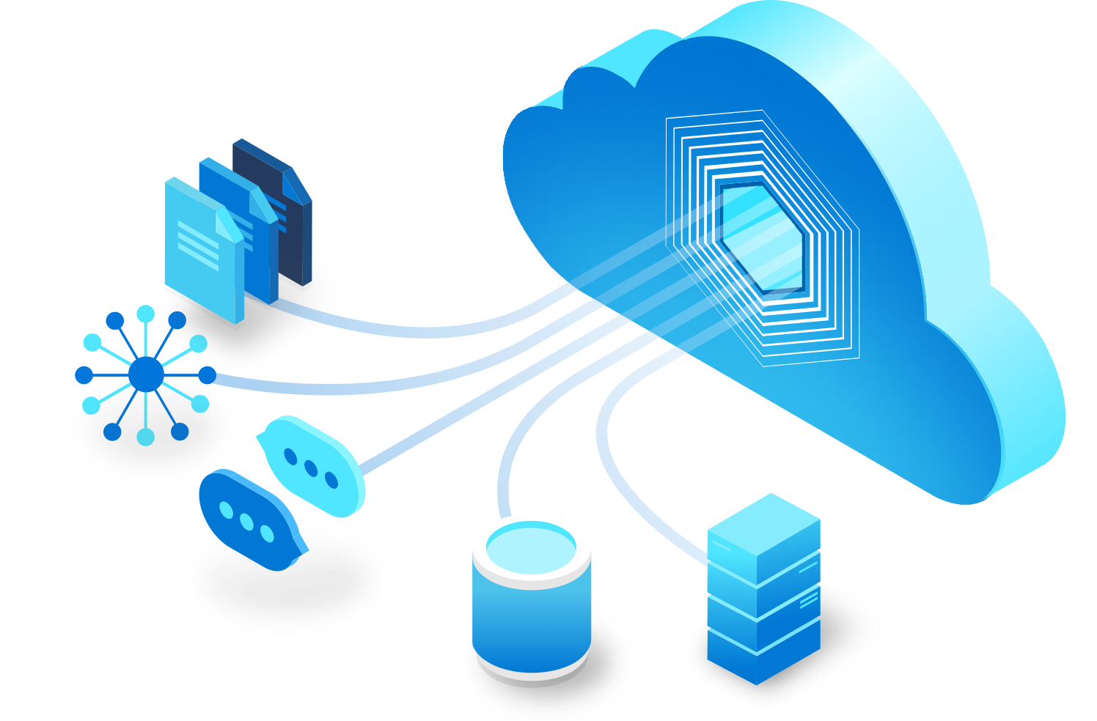
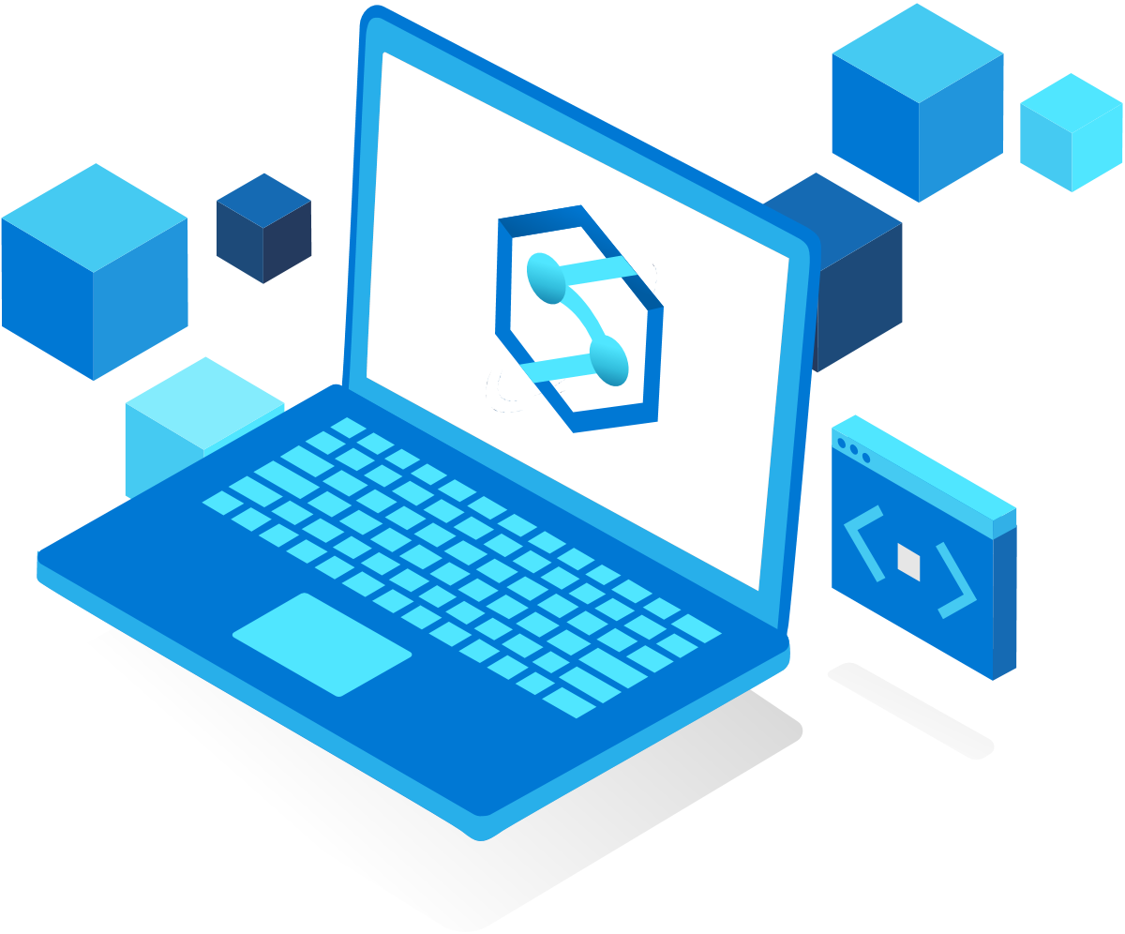
Azure Synapse Analytics
Synapse SQL
Apache Spark
for Synapse
Synapse Pipelines
Synapse Studio
Query and analyze data with T-SQL using both provisioned and serverless models
Quickly create notebooks with your choice of Python, Scala, SparkSQL, and .NET for Apache Spark
Build end-to-end workflows for your data movement and data processing scenarios
Execute all data tasks with a simple UI and unified environment
Notes:
TALK TRACK:
The product position of ASA is to provide a platform which supports enterprise entire data analytics needs including exploration, data pipeline, data warehousing, big data processing, and visualization and data governance integration. You probably will hear ASA mentioned in all the MAA track.
Synapse SQL is a distributed query system that enables enterprises to implement data warehousing and data virtualization scenarios using standard T-SQL experiences familiar to data engineers. It also offers both serverless and provisioned resources models.
Apache Spark for Synapse deeply and seamlessly integrates Apache Spark—the most popular open source big data engine used for data preparation, data engineering, ETL, and machine learning. A simplified resource model frees you from having to worry about managing clusters while allowing for fast Spark startup and aggressive autoscaling.
Synapse Pipelines comes built-in, using the same data integration engine and experiences as Azure Data Factory, allowing you to create rich data pipelines without using a separate orchestration engine. It even enables code-free ETL with data flow activities.
Synapse Studio is the web-native experience that ties everything together for data engineers, allowing them to do every task needed to build a complete solution, all in one location.

Slide 25
Data Pipeline in Synapse
Shares the same code base as ADF
Except for there is no SSIS integrated Run Time, Power Query in Synapse
Notes:
So Data Pipeline in Synapse shares the same code base as Azure Data Factory.
There are 2 major differences: 1. no SSIS. 2. No Power Query in Synapse yet

Slide 26
Synapse Demo

Slide 27
Power BI Data Flow

Slide 28
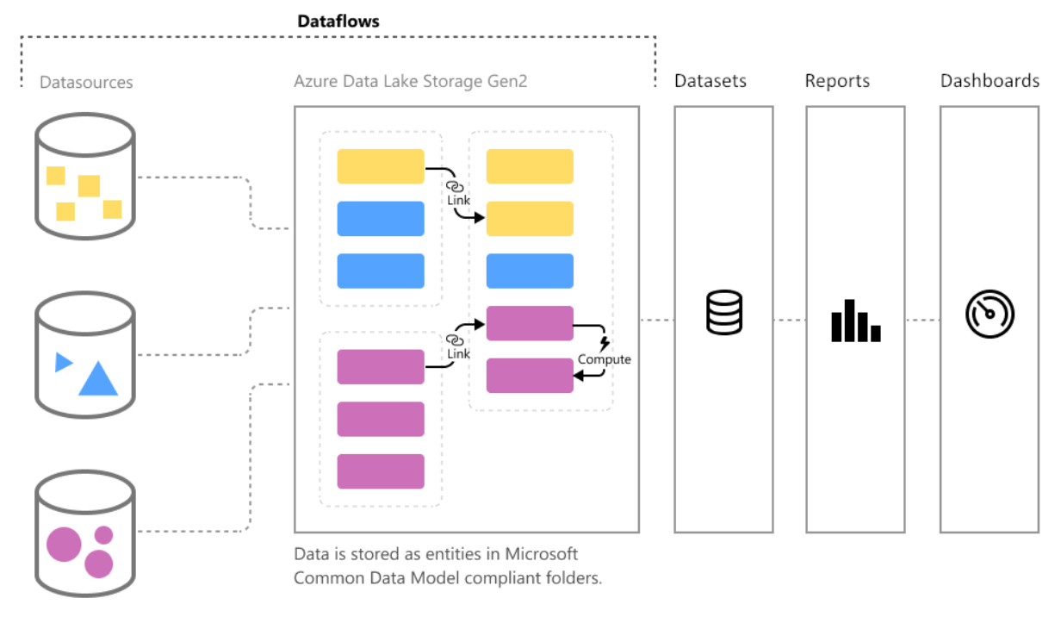
Self-service data prep in Power BI
Notes:
Dataflows in Power BI is basically a self-service data integration tool available in the Power BI service that can be used to fetch data from various data sources and create a data model on the cloud based on the schema of the datasets.
Data is stored as entities in the Common Data Model in Azure Data Lake Storage Gen2. Dataflows are created and managed in app workspaces by using the Power BI service.
Power BI introduces dataflows to help organizations unify data from disparate sources and prepare it for modeling. Dataflows are used to ingest, transform, integrate, and enrich big data by defining data source connections, ETL logic, refresh schedules, and more. In addition, the new model-driven calculation engine that's part of dataflows makes the process of data preparation more manageable, more deterministic, and less cumbersome for data analysts and report creators alike.
Dataflows are designed to use the Common Data Model, a standardized, modular, extensible collection of data schemas published by Microsoft that are designed to make it easier for you to build, use, and analyze data.

Slide 29


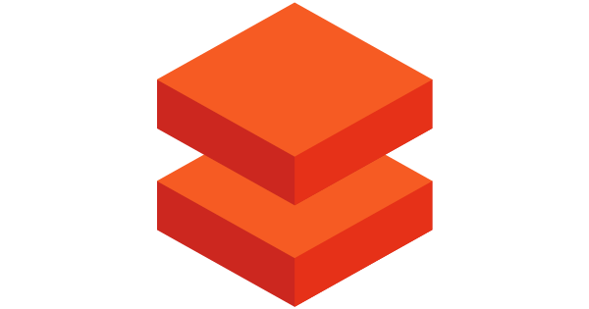

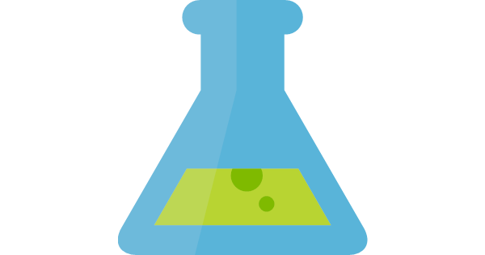
Deliver ready-made insights to Power BI users from Azure
Self service customizations
in Power BI
Dynamics 365 for Finance & Operations
Azure Data Factory
Azure Databricks
Azure Synapse Analytics
Azure ML
Dataflow
Dynamics 365 data
Azure Data Lake Storage Gen2
CDM folder
Notes:
Challenge: Provide customers with great ready-made insights in the product –and enable unconstrained self service customizations
Dyn365F&O offers best in class ready-made Analytics embedded within the product.
Provide customers with no-cliffs extensibility: Within minutes, Power BI customers should be able to extend solutions leveraging data, reports and dashboards from Dyn365F&O as well as other systems
Extensibility of existing solutions is possible at two levels
Build customization experiences within your application
Enable customization and personalization experiences within the product for users of the App
Data is still contained within the application, not visible to other applications and services
Mashing up with data from other applications and services is not possible
Make data available to applications that specialize in customizations
Leverage the power of rich, robust experiences that Power users and developers are familiar with
Allows integrating data from multiple sources including Web and IoT sensors
Customers may need to copy the data over multiple times or set up ETL infrastructure and storage to make it available
Operations and Finance + Power BI + Dataflows win, because companies can:
Quickly deploy Power BI template with customizable Reports, Dashboards with data in CDM format
Customize or enhance the templates with data from other apps or sources using Power Bi’s rich connectors
Deploy other solutions that depend on schematized data with common or custom data model without any ETL required

Slide 30
How to position Power BI Data Flow
Business Oriented/Departmental solution
Not an Enterprise ETL because it is lacking
Complex transformation
multi-step prepping
Orchestration,
strong processing compute engine
Different triggering options
CICD, etc.

Slide 31
Power BI Dataflows Demo

Slide 32
Azure Streaming Analytics

Slide 33
What is Real Time Analytics mean to you
How much latency your customer can tolerate
Batch
Micro Batch
Streaming
Balance between requirements and technical capabilities of the solution.
Notes:
Azure Streaming analytics is a service which supports real time data processing.
But first let me ask you a question: what is real time analytics means to you. This question is really asking how much latency your customer can tolerate
Data can be processed in Batch, micro batch and streaming fashion.
Difference between Batch and Micro Batch:
Making sure you can process before next batch come
Streaming processing usually means sub-second performance of data processing
there are many like ASA or Spark streaming which is more code heavy. But we will be focusing on the most common one on Azure Stream.

Slide 34
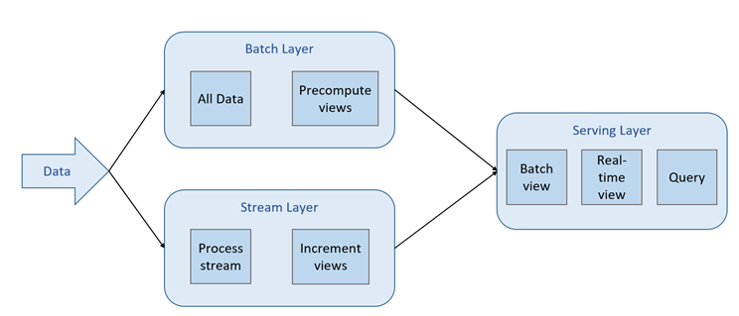
How can you create a solution where you can fit both - Lambda
Lee Stott, Microsoft UK, Big Data on Azure with No Limits Data, Analytics and Managed Clusters. Retrieved from https://blogs.msdn.microsoft.com/uk_faculty_connection/2017/02/24/big-data-on-azure-with-no-limits-data-analytics-and-managed-clusters
Notes:
A lot of emprise requires both batch and streaming processing. Thus, the Lambda data processing infrastructure come into play to support such needs.
It allows the data be processed in the batch layer and stream. Then both beening consumed in the serving layer in an independent or combined fasion.

Slide 35
PPT REM 3
Azure Stream Analytics
Programmer
Productivity
Ease of getting
started
Fully managed
Lowest TCO
Mission critical
reliability
Enterprise grade SLA
Declarative SQL like query language
Source/sink
integrations
Job Service
No cluster provisioning
Pay as you go
Notes:
I recommend Azure Streaming analytics if you are looking for a service to support streaming layer of your solution because it is fully managed, easy to use make your programmer more efficient, TCO and realiability

Slide 36

Real-time Stream Processing
Simple Event Processing
Filter
Transform
Enrich
Split
Route
Event Stream Processing
[Simple event processing] +
Aggregate
Rules
Complex Event Processing
[Event Stream Processing] +
Pattern detection
Time windows
Joins & correlations
Notes:
It supports from simple event processing to event streaming processing with functions like aggregation and rules. To Complex event processing like pattern detection, define time windows.

Slide 37
Azure Streaming Analytics Demo – refer to other sessions

Slide 38

Data Pipeline Decision Criteria
Speed
1:1 SSIS Migration
Large Scale
Self Service
Code First/Low Code
ADF
Batch/Micro Batch
Both
Synapse Pipeline
Both
Batch/Micro Batch
Low Code
Power BI Dataflow
Batch
Code First - TSQL
Streaming Analytics
Streaming
Notes:
What we’re looking at here is a general comparison of the aspects of each of these styles of data pipeline options, and more importantly how this might impact your selection criteria for using them in your overall “data acquisition” design.

Slide 39
Resources
aka.ms/maa
Partner Resources
Power BI Dataflow
GPS Partner Resources
Creating a dataflow - Power BI | Microsoft Docs
Azure Data Factory
Azure Streaming Analytics
Official Documentation Entry
Official Documentation Entry
Azure Synapse Analytics
Official Documentation Entry

Slide 40
Thank you
“We want to focus on ways to help our customers ingest data, clean it, store it at scale, and access it globally in real time. With Azure, we can rely on our own core competencies, and not have to build the underlying infrastructure.”
Nik Shroff
Director of Microsoft Solutions at Adobe

